Slide 1
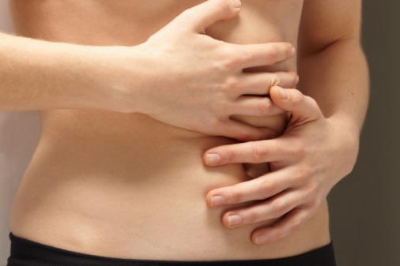
Crohn’s Disease and PTPN2
By: Katie Waldeck

Slide 2
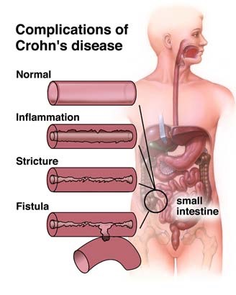
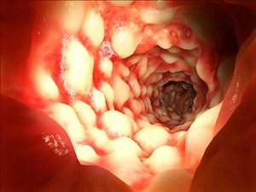
What is Crohn’s Disease?
Autoimmune disease in the intestine
Notes:
Crohn’s Disease is an autoimmune disease that affects the GI tract. Autoimmune reaction results in massiveinflammation in the GI tract and causes chronic diarrhea, fever, abdominal cramping, reduced apetite, weight loss, and bloody stool.
Who gets it..? Mainly people of european descent and ashkenazi jews but have
No cure but there are ways to manage the disease in order to stay in remission. anti-inflammatory drugs, immune system suppressors, nutrition therapy, antibiotics, and other medications used to control inflammation. In addition, surgery can be utilized as a last resort to remove a damaged part of the intestinal tract. Those bags are colostomy bags

Slide 3
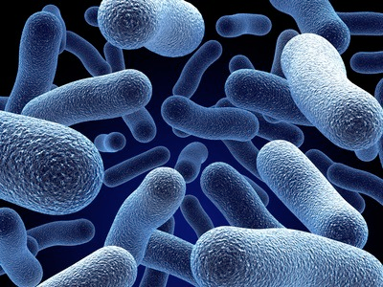
What causes Crohn’s Disease?
Genes
+
Environment
+
Gut Microbiota
Crohn’s Disease
Notes:
cigarettes - increase your risk. delay of ulcer healing. ingredients can cause mucosal death
vitamin d low - higher risk
diet - high intake of sugar and low intake of fruits and vegetables
add picture of mutated ptpn2 gene
Unknown … however they think these potential factors contribute to crown’s disease. Go into each one (Nod2 the most famous)… cigarette smoking - look at factors

Slide 4
PTPN2 gene is associated with Crohn’s
PTPc
Coiled coil
TM
Cellular Component
Biological Process
Molecular Function
Membrane
Immune Response
Glucose Metabolism
Signaling
Dephosphorylation Activity
Notes:
The PTPN2 gene on chromosome 18 encodes a tyrosine kinase protein that regulates cytokine-induced signaling pathways, epithelial barrier function, and cytokine secretion in the intestinal cells [8].
Disturbance in the PTPN2 gene causes impaired autophagosome formation, which leads to disruption of the immune system and contributes to the development of Crohn’s disease [9].
Studies identifying risk genes in people with Crohn's have found a significant link to PTPN2. The most notable research has been performed with mouse models of the disease where Crohn's phenotypes (like diarrhea and bloody stool) were observed in the mice after gene knockout of PTPN2(mouse model study). The mouse experiment demonstrates how dysfunction of PTPN2 leads to Crohn's disease, which makes PTPN2 a very vital piece to the puzzle of Crohn's disease.

Slide 5
How well conserved is PTPN2?
PTPN2
PTPc
TM
Coiled coil
415 aa
410 aa
388 aa
406 aa
393 aa
501 aa
393 aa
Ptp61F
548 aa
Notes:
PTPN2 is very well conserved across the board. It is animals with

Slide 6
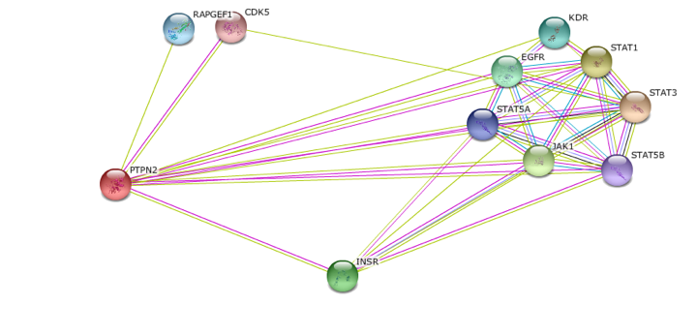
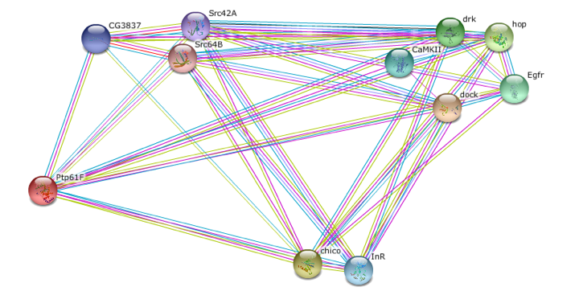
PTPN2 protein interactions are conserved
Immune Response
Immune Response
Glucose Metabolism
Glucose Metabolism
Homo Sapiens PTPN2
Drosophila Ptp61F
Notes:
The PTPN2 protein interactions are involved in the immune response like
STAT1, etc, etc…
Also found that it interacts with glucose metabolism proteins

Slide 7
PTPN2’s function in glucose metabolism is unclear
?
Insulin receptor binding
TM
Glucose homeostasis
Notes:
more specifically crown’s disease mutant function is unclear
put in where mutation is (possibly) add in picture with glucose…
List some go terms involving glucose metabolism
Maybe put something in here about Diabetes studies/ picture of diabetes
What we don’t know about glucose metabolism…
GO terms and where the gap in knowledge is

Slide 8
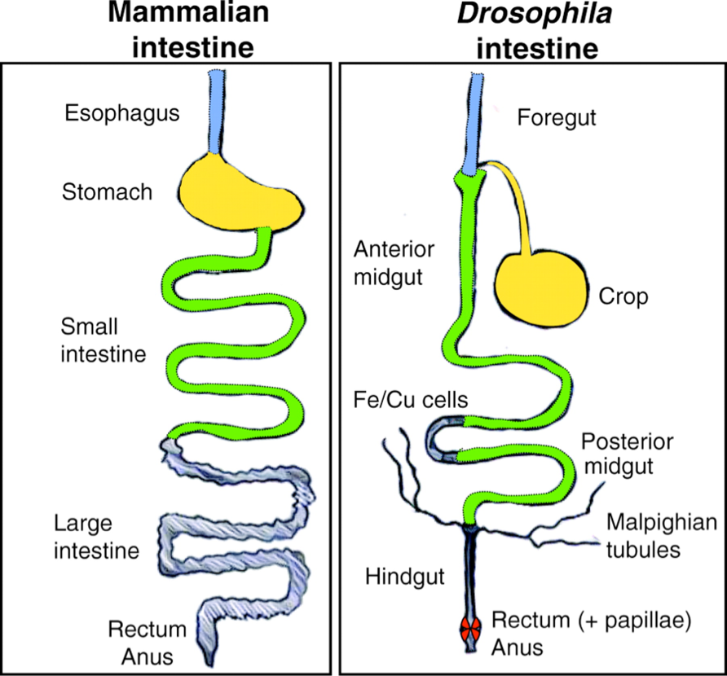
Drosophila homolog, Ptp61F, used to investigate glucose metabolism
Tm
PTPc
PTPN2
PTPc
Coiled coil
Ptp61F
Well Conserved
Notes:
drosophila ptp61f additionally

Slide 9
Hypothesis:
PTPN2 regulates proteins involved in glucose metabolism
PTPN2
PTPc
TM
Coiled coil
Ptp61F
Aim 1
Aim 2
Aim 3
Identify conserved Ptp61F interactors in regulated glucose metabolism.
Determine if glucose metabolism genes are mis-regulated in Ptp61F mutants
Determine which glucose metabolism pathway components Ptp61F is dephosphorylating.

Slide 10
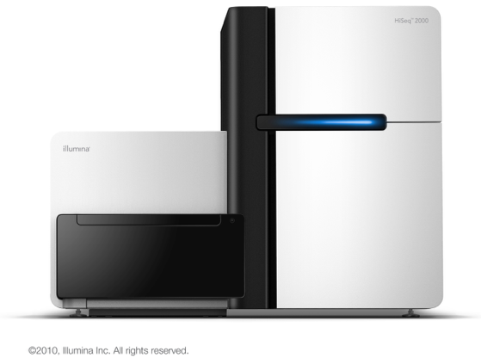
Aim 1: Determine if glucose metabolism genes are mis-regulated in PTP61F mutants.
Ptp61F WT
Illumina RNA-Seq
Ptp61F mutant
Down-regulated genes
WT
Mutant
Identify genes related with glucose metabolism using GO terms
Look for down-regulated genes in comparison to WT
Notes:
insulin binding, glucose homeostasis, glucose catabolic activity, glucagon secretion, glucagon receptor binding, glucagon receptor activity, insulin receptor binding
why illumina?
have mutant and wild type .. point to mutation
Look up what expected GO terms will be enriched among the genes that are misrelated
like… insulin binding, glucose homeostasis, glucose catabolic activity, glucagon secretion, glucagon receptor binding, glucagon receptor activity, insulin receptor binding
take the PTP61F mutant and look at which genes are misregulated with the use of RNA-sequencing

Slide 11
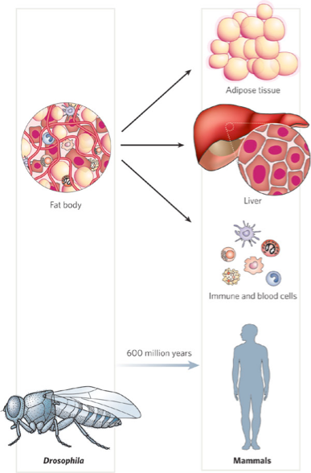
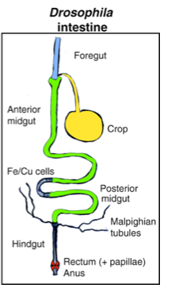
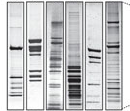
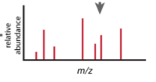
Aim 2: Identify conserved Ptp61F interactors in regulated glucose metabolism.
Intestine
Fat body (liver)
WT
Mutant
WT
Mutant
Drosophila intestine cells
Drosophila fat body (liver) cells
Use TAP-tag mass spectrometry
Identify conserved interactors (WT compared to mutant) by tagging misregulated glucose metabolism genes in liver and intestine cells
Notes:
how to identify conserved interactors… ones that are different in WT and mutant
Get tag onto protein with CRISPR, use SDS-page to elute it
Tagging misregulated glucose metabolism genes
Dock/dreadlocks gene….
http://www.ncbi.nlm.nih.gov/pubmed/21707536
why tap tag versus something else… like yeast 2 hybrid/ or coIP
TAP tag can go into nucleus
via cloning, homologous recomb, CRISPR
TAP advantages - in vivo, high yield, identifies weakly interacting, highly specific, only need to know bait protein sequence, can manipulate tap tag to alter specificity, membrane

Slide 12
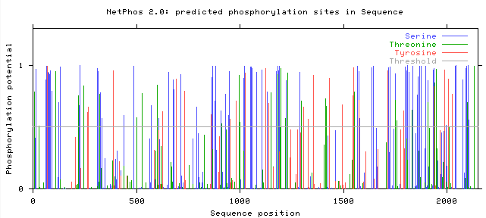
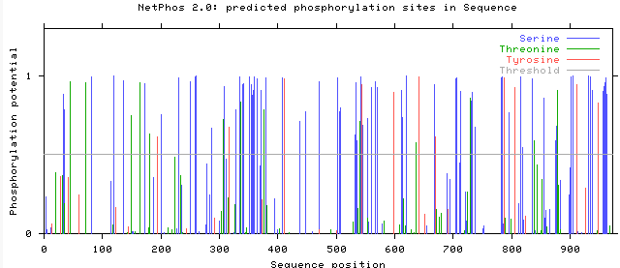
Aim 3: Determine which glucose metabolism pathway components Ptp61F is dephosphorylating.
NetPhos 2.0
Immune Response
Glucose Metabolism
InR
Chico
28 Tyr phosphorylation sites
11 Tyr phosphorylation sites

Slide 13
Aim 3: Determine which glucose metabolism pathway components Ptp61F is dephosphorylating.
Mutate sites in vivo to see if Ptp61F interaction results in mis-regulation of glucose
Chico
P
P
Glucose levels
P
P
P
P
P
P
WT
+
P
Ptp61F dephosphorylation of Chico vital for glucose metabolism
Notes:
some studies tyrosine to glutamate but difficult to do …so could potentially use CRISPR
can potentially align sites on clustal omega for conservation to make sure important in function
how to make phosphomimetic tyrosine…

Slide 14
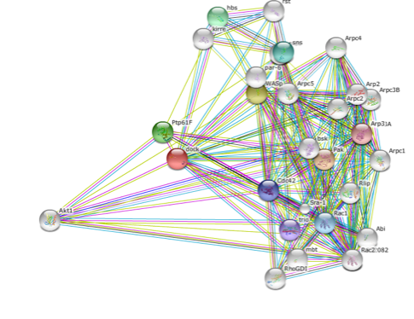
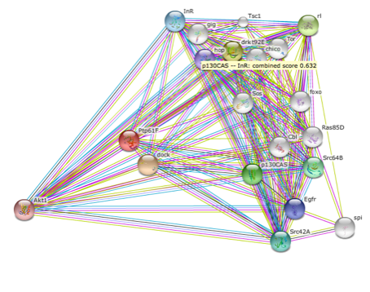
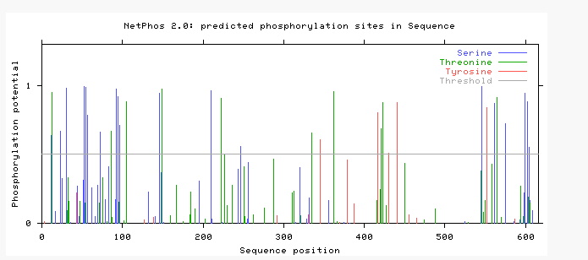
Expected results with Ptp61F mutant
Dock
[GO: insulin receptor binding]
Dock was mis-regulated in Ptp61F mutant
Instead of mass-spec used STRING to identify potential interacting protein
[Atk1]
1
2
3
4
5
Atk1 tyrosine phosphorylation sites
Input Atk1 into NetPhos 2.0 to find tyrosine phosphorylation sites
Notes:
dreadlock - involved in insulin receptor binding
Atk1 - serine/threonine kinase involved in various developmental processes. Acts downstream in PI3K and Pk61c/pdk1 in the insulin receptor transduction pathway

Slide 15
Expected results with Ptp61F mutant
Glucose levels
P
P
P
P
P
Atk1 tyrosine phosphorylation sites
WT
+
P
Ptp61F dephosphorylation of Atk1 vital for glucose metabolism

Slide 16
Future Directions
Determining if and how Ptp61F mutant is involved in glucose metabolism will greatly progress Crohn’s Disease research
PTP61F (drosophila)
PTPN2 (homo sapiens)
If find closer link to glucose metabolism….
http://images.clipartpanda.com/diabetes-clipart-Diabetes.png
????
+
Notes:
mention idea with urinary proteome…..
Drug targets… potentially alter the sites so mutant can’t mess with it.
can apply diabetes research to crohn’s disease research
link can determine if you have crohn’s disease you are at risk for diabetes… look that up as well.

Slide 17
References
http://www.ncbi.nlm.nih.gov/pmc/articles/PMC3226009/figure/F1/
http://i.cdn.turner.com/dr/hln/www/release/sites/default/files/2012/08/02/drew-baumann.jpg
http://nashvillecoloncleansecolonic.com/wp-content/uploads/2014/10/crohns.jpg
http://c1.thejournal.ie/media/2011/11/PA-6686427-310x415.jpg
http://cdn.drsircus.com/wp-content/uploads/2014/07/natutreat.jpg
http://img.webmd.com/dtmcms/live/webmd/consumer_assets/site_images/articles/health_tools/ibd_overview_slideshow/princ_rm_photo_of_chrons_disease_closeup.jpg
http://cdn29.elitedaily.com/wp-content/uploads/2014/07/ad_139903820.jpg
http://www.perkinelmer.com/CMSResources/Images/44-16836HiSeq_Render_Front_CopyRight2010.jpg
http://i.dailymail.co.uk/i/pix/2010/12/01/article-1334642-009CA6D700000259-777_468x369.jpg
http://images.wisegeek.com/stack-of-cigarettes.jpg
https://foodandhealth.com/blog/wp-content/uploads/2012/05/Screen-shot-2012-05-14-at-9.44.44-AM.png
http://i.kinja-img.com/gawker-media/image/upload/s--OxPgTwmD--/c_fit,fl_progressive,q_80,w_636/18jpma2xnl0q8jpg.jpg
http://www.oxbridgebiotech.com/wp-content/uploads/2013/08/gut-microbes.jpg

Slide 18
Questions?

