Slide 1
Crohn’s Disease and PTPN2
By: Katie Waldeck

Slide 2
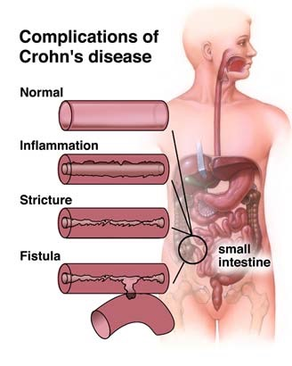
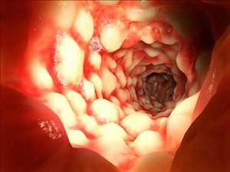
What is Crohn’s Disease?
http://c1.thejournal.ie/media/2011/11/PA-6686427-310x415.jpg
http://nashvillecoloncleansecolonic.com/wp-content/uploads/2014/10/crohns.jpg
http://i.cdn.turner.com/dr/hln/www/release/sites/default/files/2012/08/02/drew-baumann.jpg
http://cdn.drsircus.com/wp-content/uploads/2014/07/natutreat.jpg
http://cdn29.elitedaily.com/wp-content/uploads/2014/07/ad_139903820.jpg
http://img.webmd.com/dtmcms/live/webmd/consumer_assets/site_images/articles/health_tools/ibd_overview_slideshow/princ_rm_photo_of_chrons_disease_closeup.jpg

Slide 3
What is the genetic basis for Crohn’s?
Genes
+
Environment
List of potential genes involved
List of potential environmental factors involved
NOD2
Cigarette smoking
TLR4
Vitamin D
CARD9
Psychologic and behavioral factors
PTPN2
Diet
Autophagy genes (ATG16L1, IRGM, LRKK2)
Crohn’s Disease

Slide 4
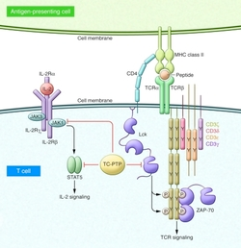
What is the role of PTPN2?
PTPN2 is involved in cell signaling in the immune response
PTPN2 (TCPTP)=protein tyrosine phosphatase, nonreceptor type 2
phosporylates targets!!!
http://www.ncbi.nlm.nih.gov/pmc/articles/PMC3226009/figure/F1/

Slide 5
How well conserved is PTPN2?
PTPc
Coiled coil
Transmembrane region
Humans
415 aa
Chimpanzee
410 aa
Cow
388 aa
Mouse
406 aa
Chicken
393 aa
Frog
501 aa
Zebrafish
393 aa
Fruit Fly
548 aa

Slide 6
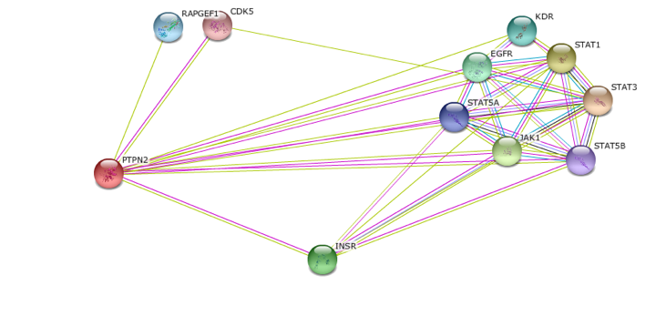
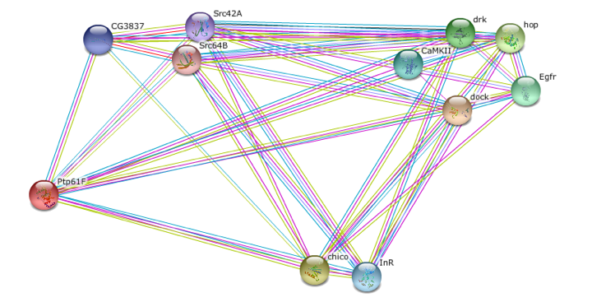
PTPN2 Protein Interactions
Homo Sapiens PTPN2
Drosophila Ptp61F

Slide 7
PTPN2 is additionally related to glucose metabolism….
PTPN2 GO Terms
Cytokine-mediated signaling pathway
Negative regulation of Interleukin-2/4/6-mediated signaling pathway
Negative regulation of tyrosine phosphorylation of Stat proteins
Interferon-gamma-mediated signaling pathway
Insulin Receptor Binding
GAP in knowledge
Glucose homeostasis
Notes:
List some go terms involving glucose metabolism
Maybe put something in here about Diabetes studies/ picture of diabetes
What we don’t know about glucose metabolism…

Slide 8
Long term goal:
To determine PTPN2’s role in glucose metabolism.
Hypothesis:
PTPN2 desphosporylates a key interactor involved in glucose metabolism
** Use PTPNP2 ortholog, Ptp61F
Aim 1
Aim 2
Aim 3
What glucose genes are misregulated in the fly model, Ptp61F mutants?
Identify conserved Ptp61F interactors in regulated glucose metabolism genes
Determine where Ptp61F is dephosphorylating glucose metabolism interactors

Slide 9
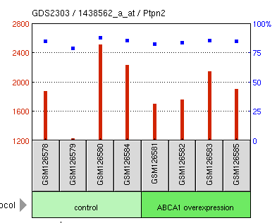
Aim 1: What glucose genes are misregulated in the Ptp61F mutants?
Ptp61F mutant
RNA-Seq
Up- and down-regulated glucose metabolism genes
Identify similar GO terms in regulated glucose metab. genes

Slide 10
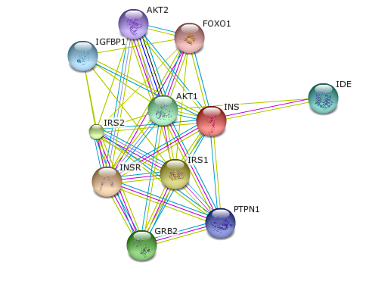
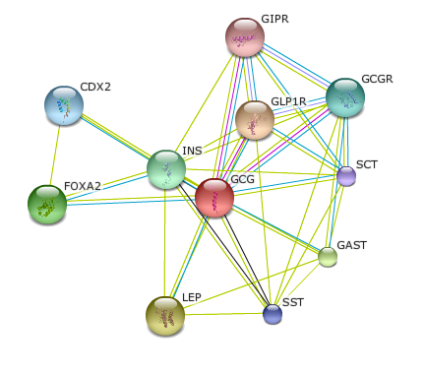
Aim 2: Identify conserved Ptp61F interactors in regulated glucose metabolism genes
Sort regulated genes based on GO terms
STRING database
Identify conserved interactors from GO-term-sorted genes that play a role in glucose metabolism

Slide 11
Aim 3: Determine where Ptp61F is dephosphorylating glucose metabolism interactors
Glucose gene (from STRING and GO terms) phosphorylation sites
X
CRISPR
Phosph. sites
Mutate phoshporylation sites on glucose genes
+
Ptp61F mutant similar to Crohns
Look for phenotypes with glucose metabolism issues —> site and genes involved in glucose regulation with Ptp61F
http://www.biotechniques.com/multimedia/archive/00188/2013-01-03-genome-e_188011a.jpg

Slide 12
Future Directions
PTP61F (drosophila)
PTPN2 (homo sapiens)
If find link to glucose metabolism….
http://images.clipartpanda.com/diabetes-clipart-Diabetes.png
????
+

